Slide 1
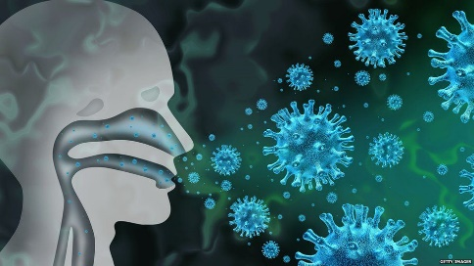
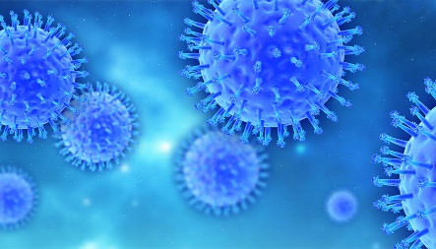
CORONA VIRUS
GOOD DAY EVRYONE I’M NOKWANDA RADEBE.TODAY I WILL BE TALKING ABOUT CORONA VIRUS. CORONA VIRUS DISEASE ALSO KNOWN AS COVID-19 IS AN INFECTIOUS DISEASE CAUSED BY A NEWLY DISCOVERED CORONA VIRUS. MOST PEOPLE WHO FALL SICK WITH COVID-19 WILL EXPERIENCE MILD TO MODERATE SYMPTOMS AND RECOVER WITHOUT SPECIAL TREATMENT.
THE VIRUS THAT CAUSES COVID-19 IS MAINLY TRANSMITTED THROUGH DROPLETS GENERATED WHEN AN INFECTED PERSON COUGHS, SNEEZES, OR EXHALES. THESE DROPLETS ARE TOO HEAVY TO HANG IN THE AIR, AND QUICKLY FALL ON FLOORS OR SURFACES. YOU CAN BE INFECTED BY BREATHING IN THE VIRUS IF YOU ARE WITHIN CLOSE PROXIMITY OF SOMEONE WHO HAS COVID-19 , OR BY TOUCHING A CONTAMINATED SURFACE AND THEN YOUR EYES, NOSE OR MOUTH.IT SPREADS THE SAME WAY OTHER CORONA VIRUSES DO, MAINLY THROUGH PERSON TO PERSON CONTACT. INFECTIONS RANGE FROM MILD TO DEADLY. AN EARLY CHINESE STUDY OF 103 COVID-19 CASES FOUND TWO STRAINS, WHICH THEY NAMED L AND S. THE S TYPE IS OLDER, BUT THE L TYPE WAS MORE COMMON IN EARLY STAGES OF THE OUTBREAK. THEY THINK ONE MAY CAUSE MORE CASES OF THE WORKING ON WHAT IT ALL MEANS. THE VIRUS CAN LEAD TO PNEUMONIA, RESPIRTORY FAILURE, HEART PROBLEMS, LIVER PRBLEMS, SEPTIC SHOCK, AND DEATH. MANY COVID-19 COMPLICATIONS MAY BE CAUSED BY CONDITI0N KNOWN AS CYTOKINE RELEASE SYNDROME OR A CYTOKINE STORM. THIS IS WHEN AN INFECTION TRIGGERS YOUR IMMUNE SYSTEM TO FLOOD YOUR BLOODSTREAM WITH INFLAMMATORY PROTEINS CALLED CYTOKINES. THEY CAN KILL TISSUE AND DAMAGE YOUR ORGANS.
THERE’S NO SPECIAL TREATMENT FOR COVID-19. PEOPLE WHO GET A MILD CASE NEED CARE TO EASE THEIR SYMPTOMS, LIKE REST, FLUIDS, AND FEVER CONTROL. TAKE OVER-THE-COUNTER MEDICINE FOR A SORE THROAT, BODY ACHES, AND FEVER. BUT DON’T GIVE ASPRIN TO CHILDREN OR TEENS YOUNGER THAN 19. YOU MIGHT HAVE HEARD THAT YOU SHOULDN’T TAKE IBUPROFEN TO TREAT COVID-19 SYMTOMS. BUT THE NATIONAL INSTITUTES OF HEALTH SAYS PEOPLE WHO HAVE THE VIRUS CAN USE NONSTEROIDAL ANTI-ACETAMONOPHEN AS USUAL.

